Slide 1






Slide 2

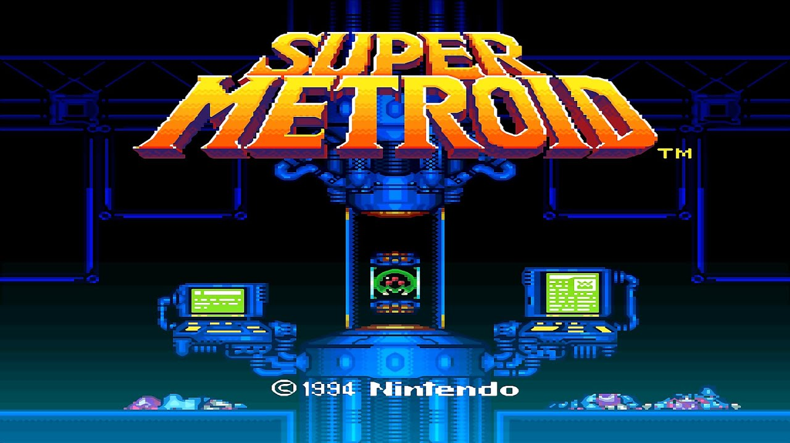
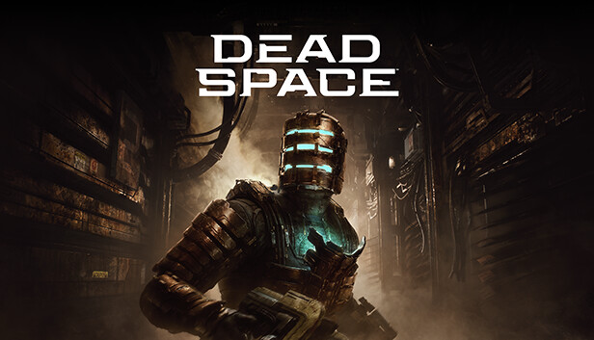
A Survival-Horror/Metroidvania hybrid
The iconic gameplay of a Metroidvania with the terror of a horror game.
fusing horror chase sequences and events that make the player vulnerable with classic metroidvania level exploration and mechanics.

Slide 3
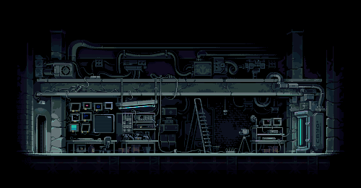
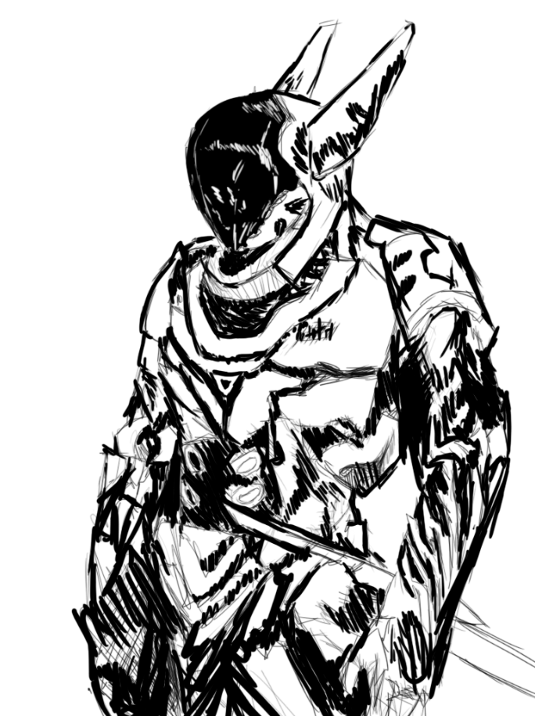
A broken world, one live with robots
Humanity is long gone. In its place are bots now living in the ruins of human rubble. But now a virus has caused most robots to become hostile. You play as a bot who has mysteriously woken up and has been given an objective to stop this new virus and find out who is causing all this chaos.

Slide 4

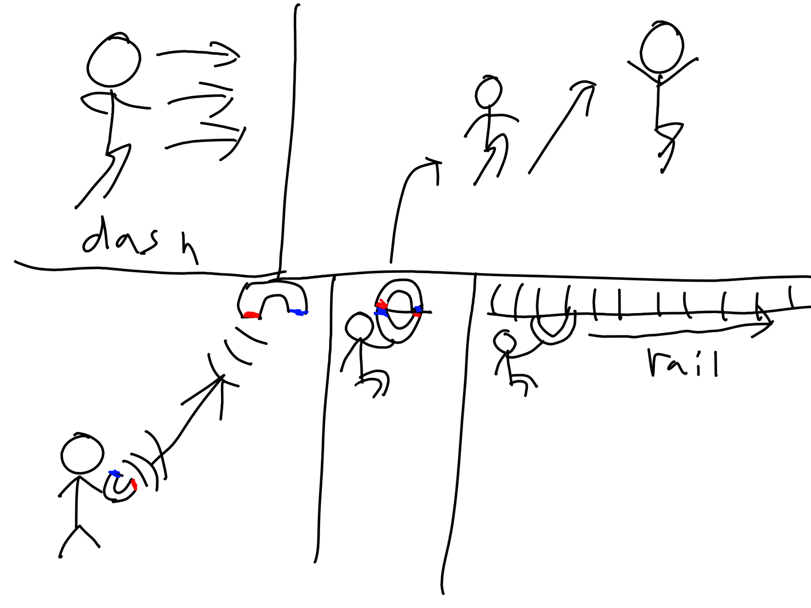
Gain New Abilities to help in exploring the factory
Abilities to use for movement and traversal.
When you explore, you can find new abilities from the old broken bots that will allow for better traversal and for puzzle solving.

Slide 5
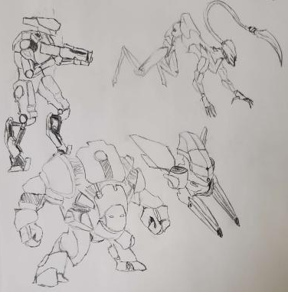
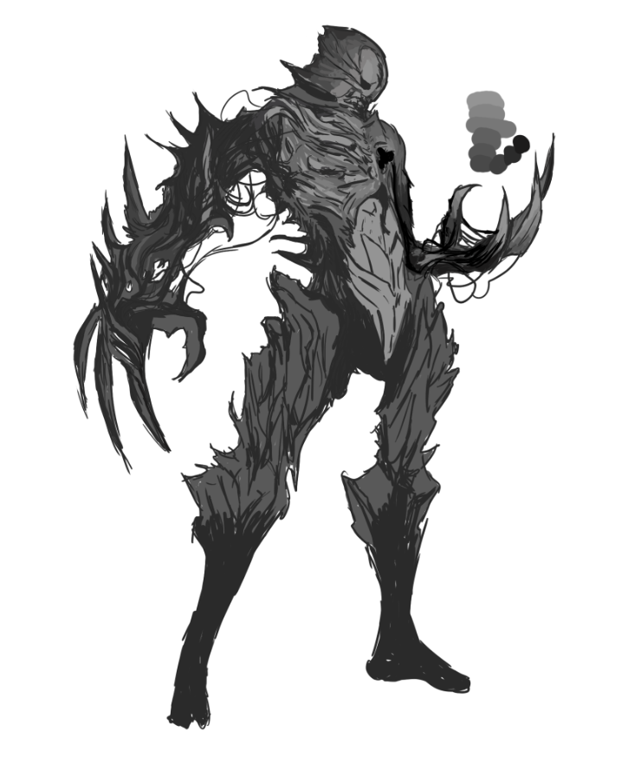
The Dangers and fear you will face
Deal with both dangerous enemies and hazards, all will try to kill you.
Also deal with the unique Hunters, robotic monsters designed to hunt you down like a animal and are invincible — AVOID AT ALL COST.
Common enemies
Hunters

Slide 6
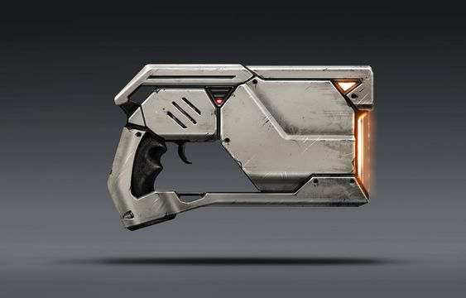

Combat
Combat in the game is focused on dealing with enemies by dodging and avoiding their attacks through platforming.
You only have two kinds of weapons to start: the Blade and the Energy Pistol. Earn XP from fighting to make yourself stronger by upgrading your weapons.
Both your blade and gun use energy, a resource that is limited. When you run out, you’ll be forced to avoid your enemies.

Slide 7

In Summary
A 2d Metroidvania game focused on horror and survival.
Explore an abandoned factory with unique setting like the Mecha Grave, Magma Assembly Line, Magnetice Chambers, Destroyed Gardens, and the Laboratory.
Be chased by terrifying Hunter bots made to hunt down other robots — with risk of losing progress.
Gain new Abilities to help traverse this unforgiving land and avoid new dangers along the way.

Slide 8



What is it on?
PC on Steam
Xbox and Playstation

Slide 9
Thank
you!

